Slide 1

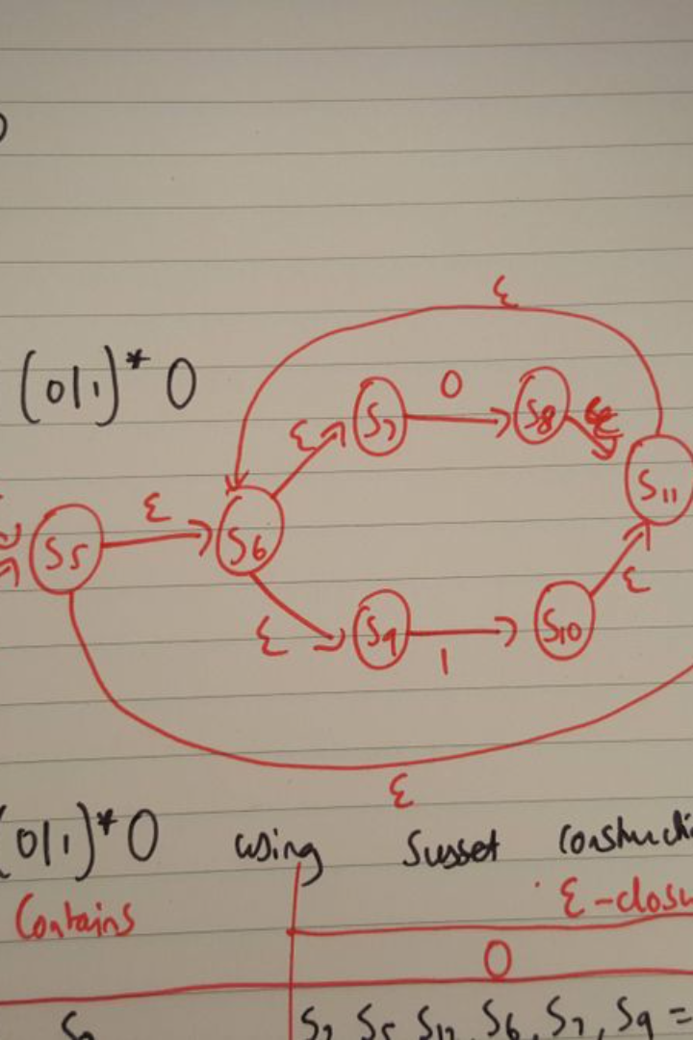
Exploring Intermediate Representations in Compiler Design
Compiler design plays a pivotal role in transforming high-level programming languages into executable machine code, bridging the gap between human-readable code and the language understood by the computer hardware. One of the crucial phases in this intricate process is the generation and manipulation of intermediate representations (IRs). Intermediate representations serve as an intermediary abstraction layer between the source code and the target machine code, facilitating various optimizations and analyses to enhance program efficiency.
This project delves into the exploration of intermediate representations within the realm of compiler design. The primary objective is to unravel the significance of these representations, examining their role in the optimization and translation processes. By comprehensively studying different intermediate representation techniques, this project aims to shed light on the various design choices, trade-offs, and impacts on the overall performance of the compiled code.

Slide 2
Project Objectives
1
Investigate novel IR design choices
Analyze existing IR structures and identify potential limitations for optimization.
2
Develop efficient IR optimization techniques
Evaluate existing IR optimization techniques and analyze their effectiveness for specific performance metrics.
3
Quantify the impact of IR choices and optimizations
Conduct performance evaluations on various target platforms using benchmark suites and real-world applications.
4
Contribute to the understanding of IR design and optimization
Disseminate research findings through publications, presentations, and open-source code contributions.

Slide 3
Literature Review
Previous studies in compiler design
Recent works
Extensively explored the significance of intermediate representations (IRs) as a crucial bridge between high-level programming languages and machine code.
Delve into novel IR designs and optimizations to address emerging challenges, providing a comprehensive foundation for this project's exploration of IR intricacies in compiler construction.

Slide 4

Methodology
1
Extensive literature review
2
Classification and comparison phase
To survey existing research and gain a comprehensive understanding of the diverse IR structures, their applications, and associated optimization techniques.
Systematically categorizing popular IR forms such as Abstract Syntax Trees (ASTs), Three-Address Code (3AC), and Static Single Assignment (SSA).

Slide 5
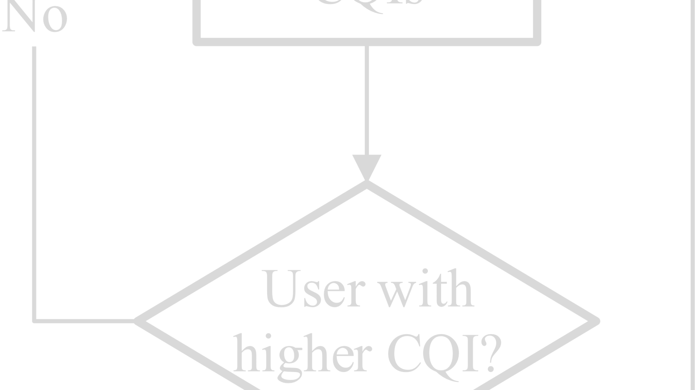
Register Allocation Algorithms
Performance Optimization
Enabling Further Optimizations
Register access is significantly faster than memory access. Effective register allocation algorithms minimize the need for memory spills, leading to faster program execution and improved performance.
Register allocation sets the stage for other optimizations. By knowing which variables reside in registers, techniques like constant folding, dead code elimination, and instruction scheduling can become more effective.

Slide 6



Intermediate Representation
Abstract Syntax Trees (ASTs)
Three-Address Code (3AC)
Static Single Assignment (SSA) form
Common representation facilitating various optimization techniques and easing the translation process.
Widely used representations capturing the essential semantics of the source program in a more structured and uniform manner.
Utilized for data flow analysis and optimization, emphasizing its benefits for program analysis.

Slide 7



Implementation Details
Building an IR builder
This module parses source code, generates the chosen IR representation, and stores it efficiently.
Developing IR optimization passes
These passes analyze and transform the IR, implementing algorithms tailored to the specific IR structure and optimization goals.

Slide 8
Result and Analysis
Evaluation of compiled code's performance
Assessed in terms of execution speed, memory usage, and code size for a diverse set of programs.
Comparative studies between IRs
Highlighting the impact of representation choices on the overall compiler efficiency.

Slide 9
THANK YOU

